Slide 1


Cargo Vehicle Allotment Agent
An New Introduction
Guided By:
Mrs.M.Saratha,B.Tech,M.E
(Assistant Professor / Artificial Intelligence)

Slide 2
Team Members
01
02
03
Deepika Merlin N (927622BAL006)
Jayanthan S (927622BAL016)
Varshini S (927622BAL053)

Slide 3
Table of contents
01
02
03
04
05
06
Introduction
Literature Survey
Problem Statement
Proposed Architecture
Conclusion
Reference

Slide 4
01
Introdution

Slide 5
ABSTRACT
The Cargo Vehicle Allotment Agent (CVAA) is an innovative solution designed to revolutionize the logistics and transportation industry. This system employs advanced algorithms and real-time data analysis to automate and optimize the allocation of cargo vehicles to shipments. The CVAA addresses the challenges of traditional manual allocation processes by enhancing efficiency, adaptability, and cost-effectiveness

Slide 6
Chapter 1
Objectives
Efficiency Boosting:
Assign freight cars as efficiently as possible,
Taking into account variables like proximity, capacity, and delivery window lengths.
By optimizing vehicle utilization, you may cut down on idle time and save fuel.

Slide 7
Flexibility in real time:
React instantly to sudden variations in the amount of shipments, urgency, and route alterations.
Deliver urgent items first, and be flexible in case of unforeseen events.
Making Use of Resources:
Assure optimal utilization and maintenance schedule by effectively managing the fleet of cargo vehicles.

Slide 8
Flexibility in real time:
React instantly to sudden variations in the amount of shipments, urgency, and route alterations.
Deliver urgent items first, and be flexible in case of unforeseen events.
Lowering Expense:
Reduce operating expenses by allocating vehicles and creating an optimal route.
Find areas where money can be saved by using performance tracking and data analytics.

Slide 9
02
Literature Survey

Slide 10
S N0 | Year | Title | Author | Algorithm
1 | 2018 | "Real-time Fleet Management and Vehicle Tracking System for Cargo Distribution“ | A. Smith, B. Johnson | Integration of Real-time GPS Tracking and Machine Learning for Route Optimization.
2 | 2017 | "Optimizing Cargo Allotment in Supply Chain Logistics Using Advanced Tracking Technologies“ | C. Williams, D. Miller | Dynamic Programming Approach for Cargo Allocation Considering Real-time Traffic Conditions.

Slide 11
3 | 2019 | "GPS-based Vehicle Tracking Systems for Efficient Cargo Management“ Authors: E. Brown, F. Davis | E. Brown, F. Davis | Geofencing and Clustering for Route Planning and Monitoring.
4 | 2017 | "Enhancing Freight Visibility: A Comprehensive Review of Cargo Tracking Solutions“ | G. Anderson, H. White | International Journal of Transportation Science and Technology

Slide 12
ARTICLE SURVEY
The transport network and supply chain is a complex combination of characters that they need co-ordination, collaboration and sharing of information for the purpose of expansion productivity and efficiency (Choi and Krause, 2006; Myerson, 2007).
The concept of tracking and tracing involves managing consecutive links between collections and operating units throughout the entire supply chain network. Growing complexity and uncertainty in between business-to-business relationships as well as business and customer can be overcome through implementation of Auto-ID enabled tracking and tracking solutions.

Slide 13
A supply a chain network simultaneously carries a large number of goods that need a delivery system to reduce the cost associated with logistics and staff to process customers claims (Ko et al., 2011).
An independent delivery tracking system contributes to the reduction of claim costs due to freight forwarding errors. There is a growing need for tracking and tracking in the supply chain, by law demand grows harder, and there is a growing momentum of improvement standard systems to address such transportation needs (Kandel et al., 2011).

Slide 14
Cargo Vehicle Allotment and Scheduling:
Desrochers, M., & Villeneuve, D. (1995). Vehicle routing. In Fleet Management and Logistics (pp. 261-302). Springer.
Cordeau, J. F., Gendreau, M., & Laporte, G. (2003). A tabu search heuristic for the vehicle routing problem with time windows. Transportation Research Part B: Methodological, 37(6), 579-594.
Agent-Based Systems in Transportation:
Ossowski, S. (Ed.). (1998). Cooperative information agents II. Springer Science & Business Media.
Nair, S. A., & Rajasekaran, T. (2011). Agent-based systems in intelligent transport systems: A survey. Expert Systems with Applications, 38(10), 14334-14347.
Blockchain in Supply Chain and Cargo Management:
Swan, M. (2015). Blockchain: blueprint for a new economy. O'Reilly Media, Inc.
Miao, M., Xu, L. D., He, W., & Wu, Y. (2016). A survey of blockchain-based systems. Future Generation Computer Systems, 86, 159-176.

Slide 15
Advantages of this Existings
Optimized Resource Utilization
Enhanced Operational Efficiency
Real-time Monitoring and Tracking
Cost Reduction
Increased Customer Satisfaction
Data-Driven Decision Making

Slide 16
Disadvantages of this Existings
Initial Implementation Costs
Dependency on Technology
Resistance to Change
Unforeseen Technical Issues
Limited Flexibility

Slide 17
Problem Statement
03

Slide 18
Problem Statement
Global trade depends on the logistics and transportation sector to get goods from producers to consumers in a timely and effective manner.
The procedure involves assigning cargo vehicles to shipments, which is a crucial part that is usually done by hand using manual planning and decision-making techniques.
The requirement for a smart solution that maximizes vehicle allotment, improves efficiency, and reacts to real-time changes in supply.
Demand is expanding as the sector develops and faces more complexity.

Slide 19
Proposed Methodology
Inefficiency in Vehicle Allocation:
Traditional methods of manually assigning cargo vehicles to shipments are time-consuming and prone to human error.
Inefficient allocation leads to suboptimal use of resources, including underutilized vehicles and increased operational costs.
Dynamic Nature of Logistics:
The logistics landscape is characterized by dynamic changes in shipment volume, delivery urgency, and unexpected disruptions.
Existing systems often struggle to adapt in real-time, resulting in delays, increased fuel consumption, and missed delivery deadlines.

Slide 20
Lack of Real-time Monitoring:
Limited visibility into the real-time status and location of cargo vehicle.
Manual tracking systems are prone to inaccuracies and may not provide the necessary insights for proactive decision-making.
Integration Challenges:
Existing logistics and transportation management systems often operate in silos, hindering seamless data exchange and coordination.

Slide 21
For Web Application
Front End → HTML,JavaScript,CSS,Bootstrap
Backend → Python,Django,Tensorflow
Database → MongoDB
ML Algorithm → R Programming
Integration Challenges:
In this Website we are implementing with Artificial Intelligence Techniques

Slide 22
Need for a Cargo Vehicle Allotment Agent:
To address these challenges, there is a pressing need for a sophisticated Cargo Vehicle Allotment Agent.
This agent should leverage advanced algorithms, real-time monitoring, and seamless integration to optimize the allocation of cargo vehicles, adapt to dynamic logistical changes, and enhance overall efficiency.

Slide 23
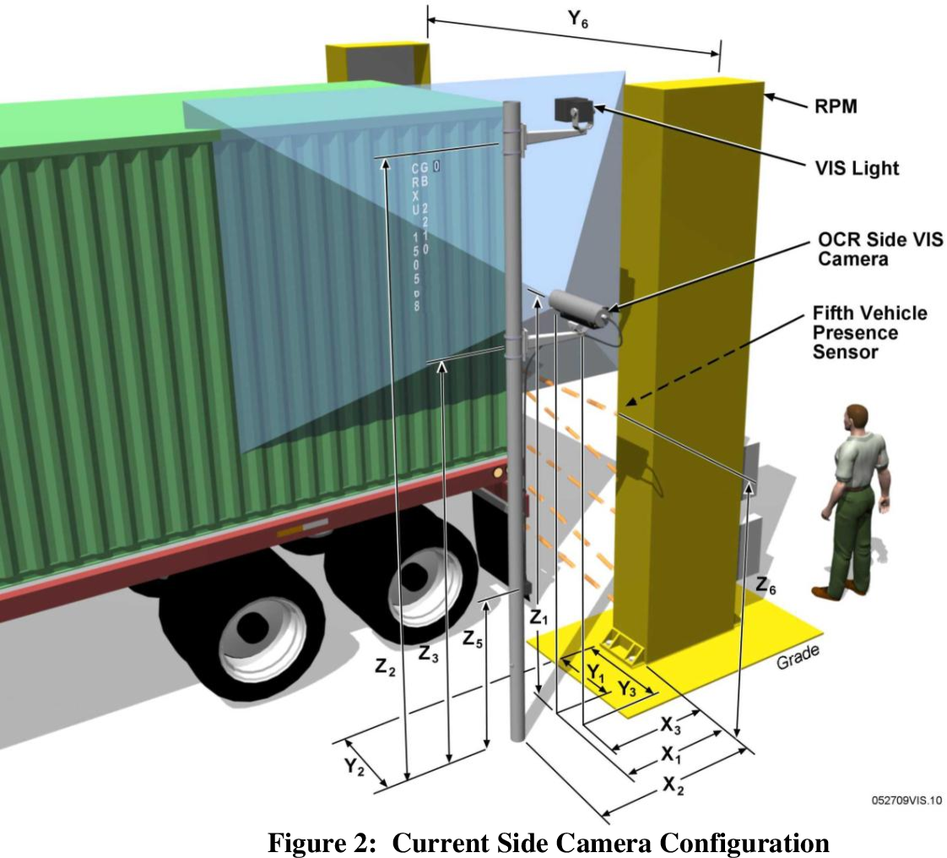
Image Recognition
Gather a labeled dataset that includes images of cargo vehicles along with corresponding annotations indicating the relevant information (e.g., vehicle type, license plate, cargo size).

Slide 24
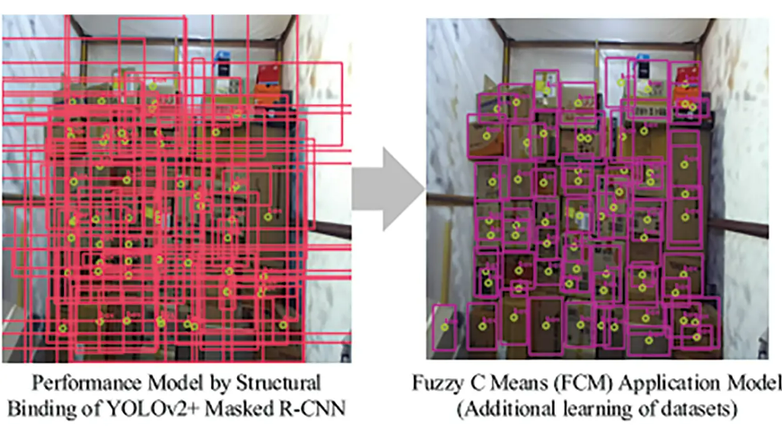
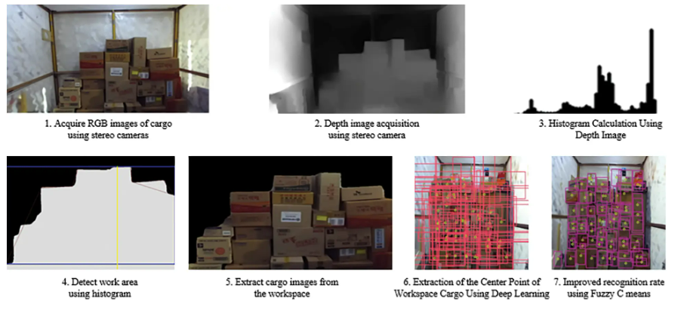
Convolution Neural Network
Convolutional Neural Networks (CNNs or ConvNets) are a class of deep neural networks designed for tasks such as image recognition, object detection, and image classification. CNNs have proven to be very effective in these domains due to their ability to learn hierarchical representations of features directly from raw pixel data.

Slide 25
Source Code For CNN :
import tensorflow as tf
from tensorflow.keras import layers, models
model = models.Sequential()
model.add(layers.Conv2D(32, (3, 3), activation='relu', input_shape=(64, 64, 3)))
model.add(layers.MaxPooling2D((2, 2)))
model.add(layers.Conv2D(64, (3, 3), activation='relu'))
model.add(layers.MaxPooling2D((2, 2)))
model.add(layers.Conv2D(64, (3, 3), activation='relu'))
model.add(layers.Flatten())
model.add(layers.Dense(64, activation='relu'))
model.add(layers.Dense(num_classes, activation='softmax'))
model.compile(optimizer='adam',
loss='categorical_crossentropy',
metrics=['accuracy'])

Slide 26
Training Methadolody of Model:
model.fit(train_images, train_labels, epochs=10, validation_data=(test_images, test_labels))

Slide 27
Evaluation and Prediction Methadolody of Model:
test_loss, test_acc = model.evaluate(test_images, test_labels)
print(f'Test accuracy: {test_acc}’)
predictions = model.predict(new_images)

Slide 28
Google API Integrated :
Description:
Provides programmatic access to Google Maps features, allowing developers to embed maps on web pages or integrate location-based services into applications.
Documentation: Google Maps Platform

Slide 29
Source code for G-API:
<!DOCTYPE html>
<html lang="en">
<head>
<meta charset="UTF-8">
<meta name="viewport" content="width=device-width, initial-scale=1.0">
<title>Your Google Maps Project</title>
<!-- Replace 'YOUR_API_KEY' with the actual API key you obtained -->
<script src="https://maps.googleapis.com/maps/api/js?key=YOUR_API_KEY&libraries=places" defer>
</script>
</head>
<body>
<!-- Your content goes here -->
</body>
</html>

Slide 30
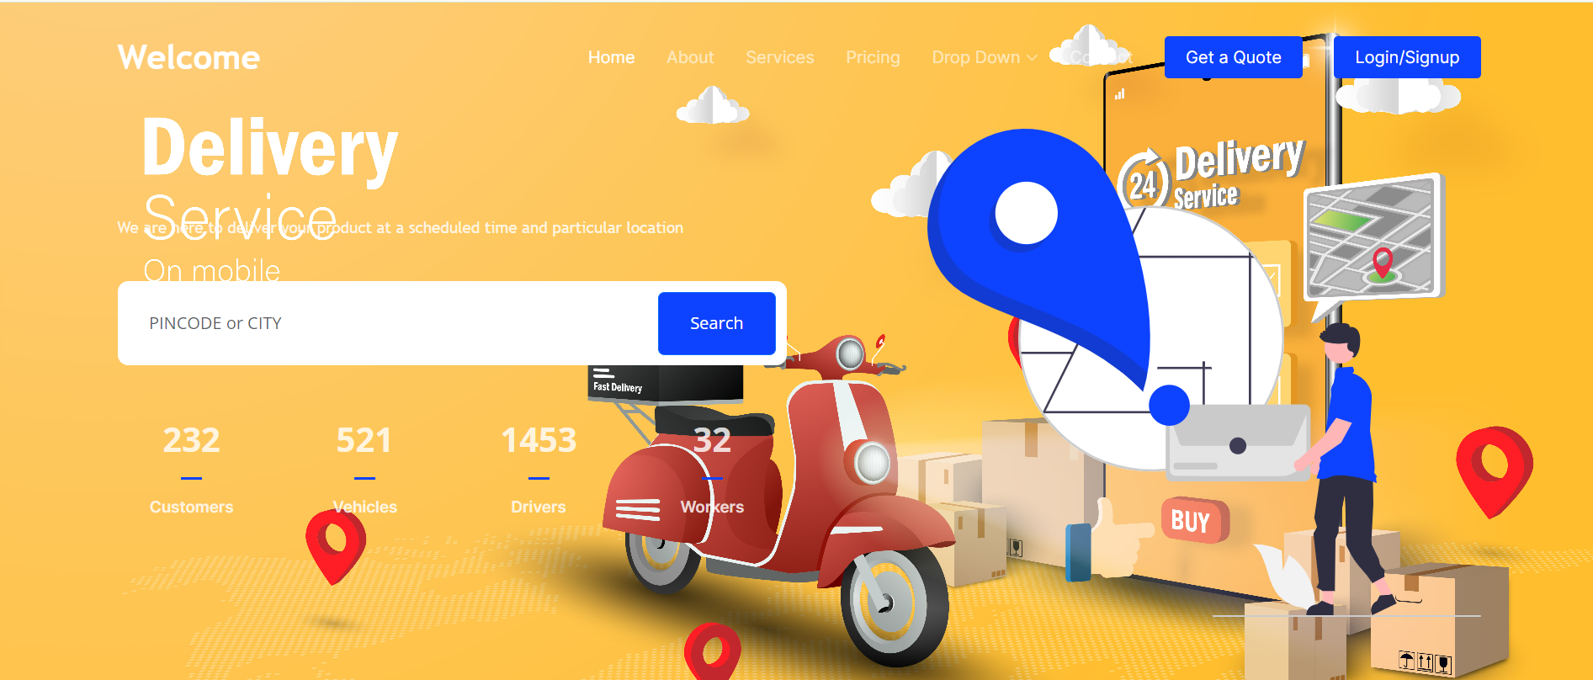

Slide 31
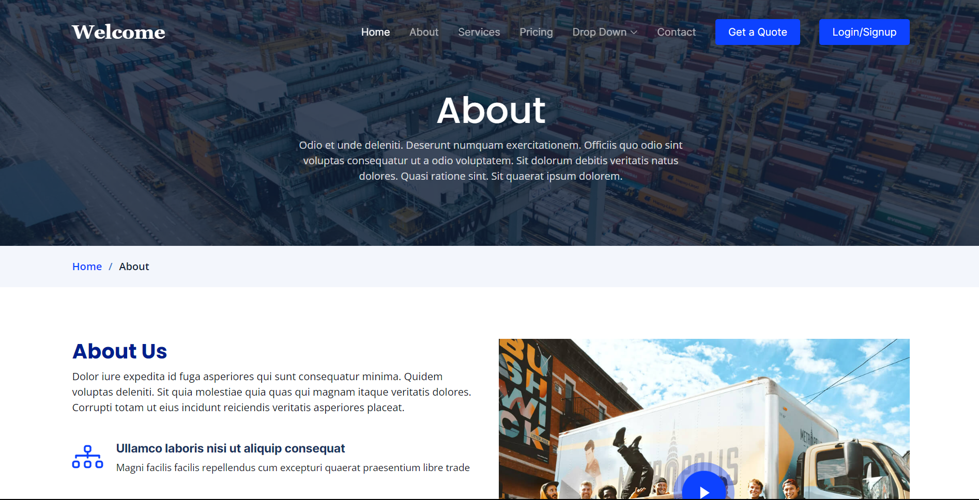

Slide 32



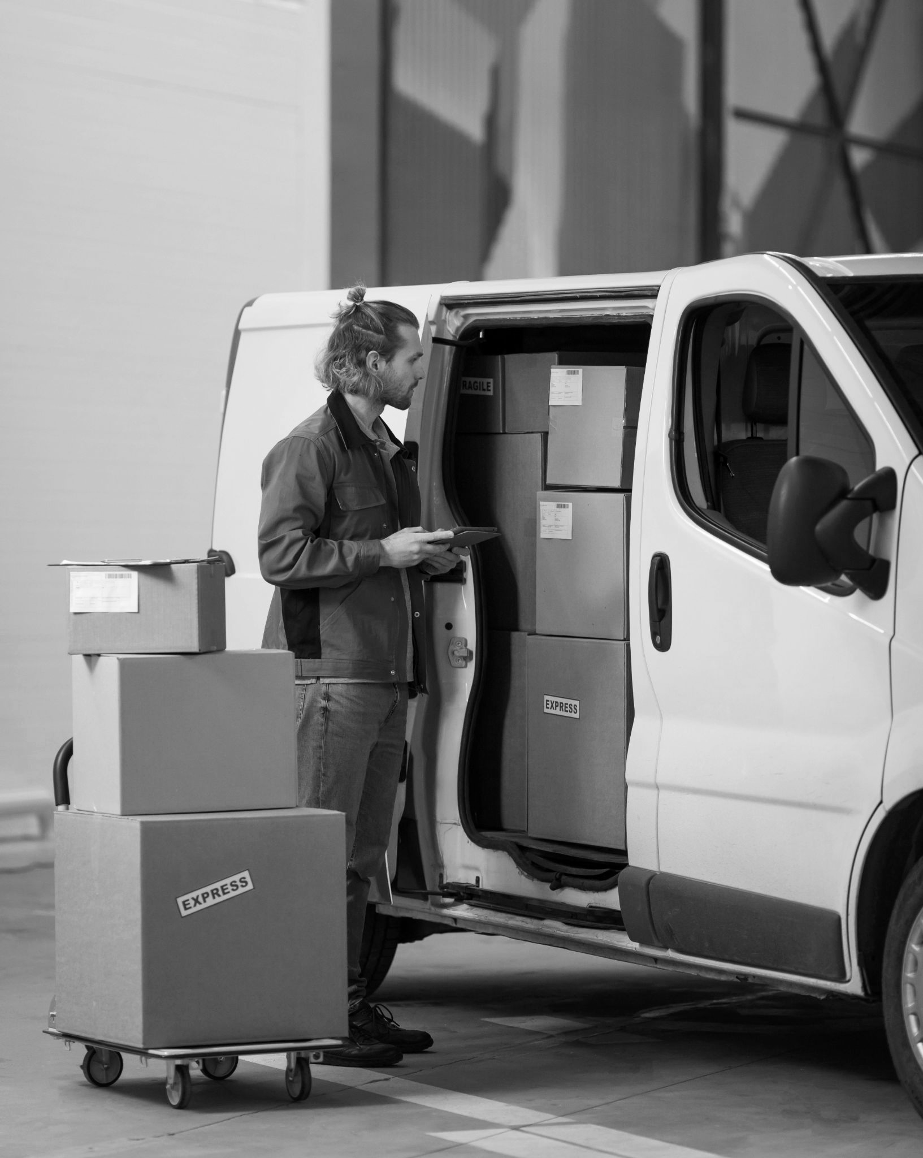
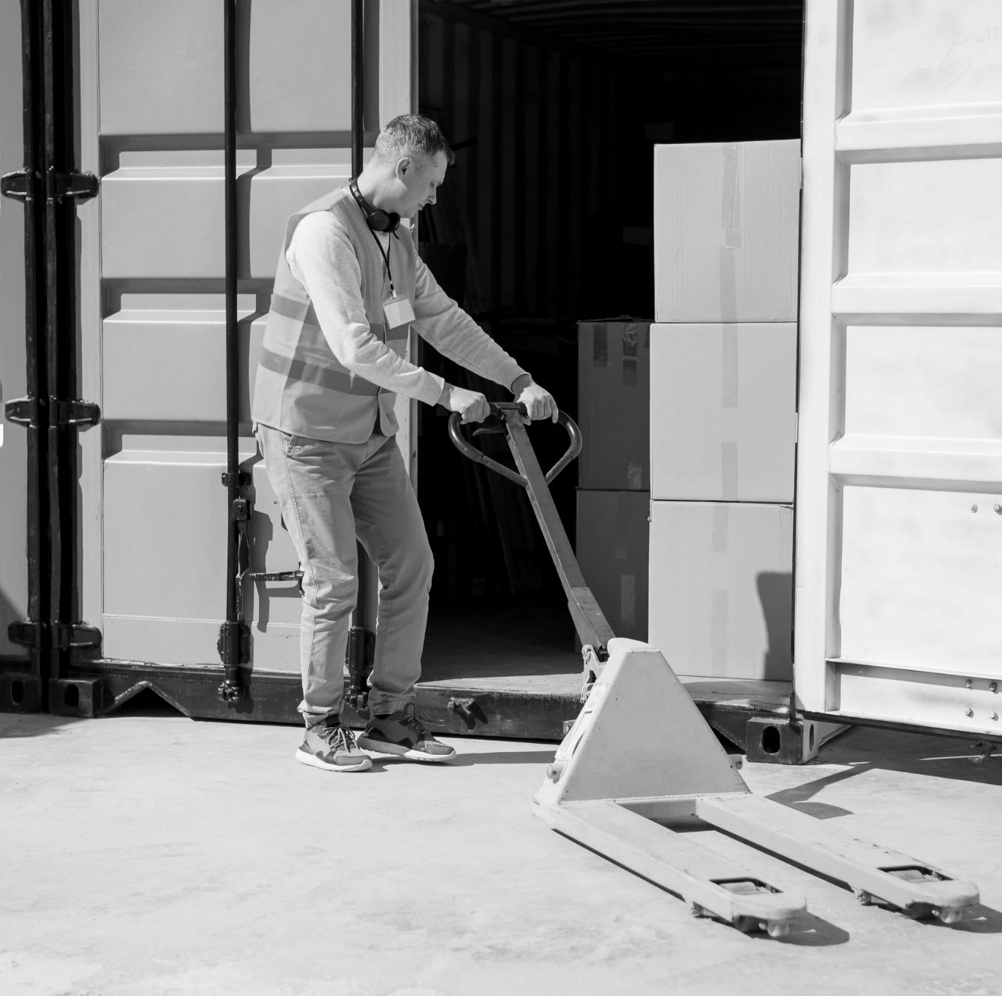
Safeness

Slide 33
Conclusion
06

Slide 34
Conclusion
To overcome the inefficiencies and difficulties present in the current logistics environment, a Cargo Vehicle Allotment Agent must be developed. The system intends to greatly enhance the allocation process, lower operating costs, and raise the general effectiveness and competitiveness.

Slide 35
07
Reference

Slide 36
Reference
Location Tracking in GPS using Kalman Filter through SMS
IEEE EUROCON, pp. 1707-1711, 2009.
A Smart Cargo Tracking System based on location-alert service and QR code
A. Deebika Shree, J. Anusuya, and S. Malathy,
Real-Time Tracking Management System Using GPS
IEEE 5th International Conference on Electrical Engineering/Electronics, Vol. 1, pp. 393–396, 2008
(4) Huk K., Robaszkiewicz- Ostre˛ga J., (2018). Logistyka zwroto´w na przykładzie hurtowni farmaceutycznej Neuca-Logistyca sp. z o.o., Prace Naukowe Uniwersytetu Ekonomicznego we Wrocławiu, ,,Globalne i lokalne strategie logistyczne’’, Wydaw. Uniwersytetu Ekonomicznego we Wrocławiu, Wrocław, No 505, 2018, p. 303–314.

Slide 37


Slide 38


